Slide 1
Beam
Botanical eradication and management machine
Group 1
TJ Jones
Ryan Takiff
Suhyun Hwang
Daemy Luzardo

Slide 2

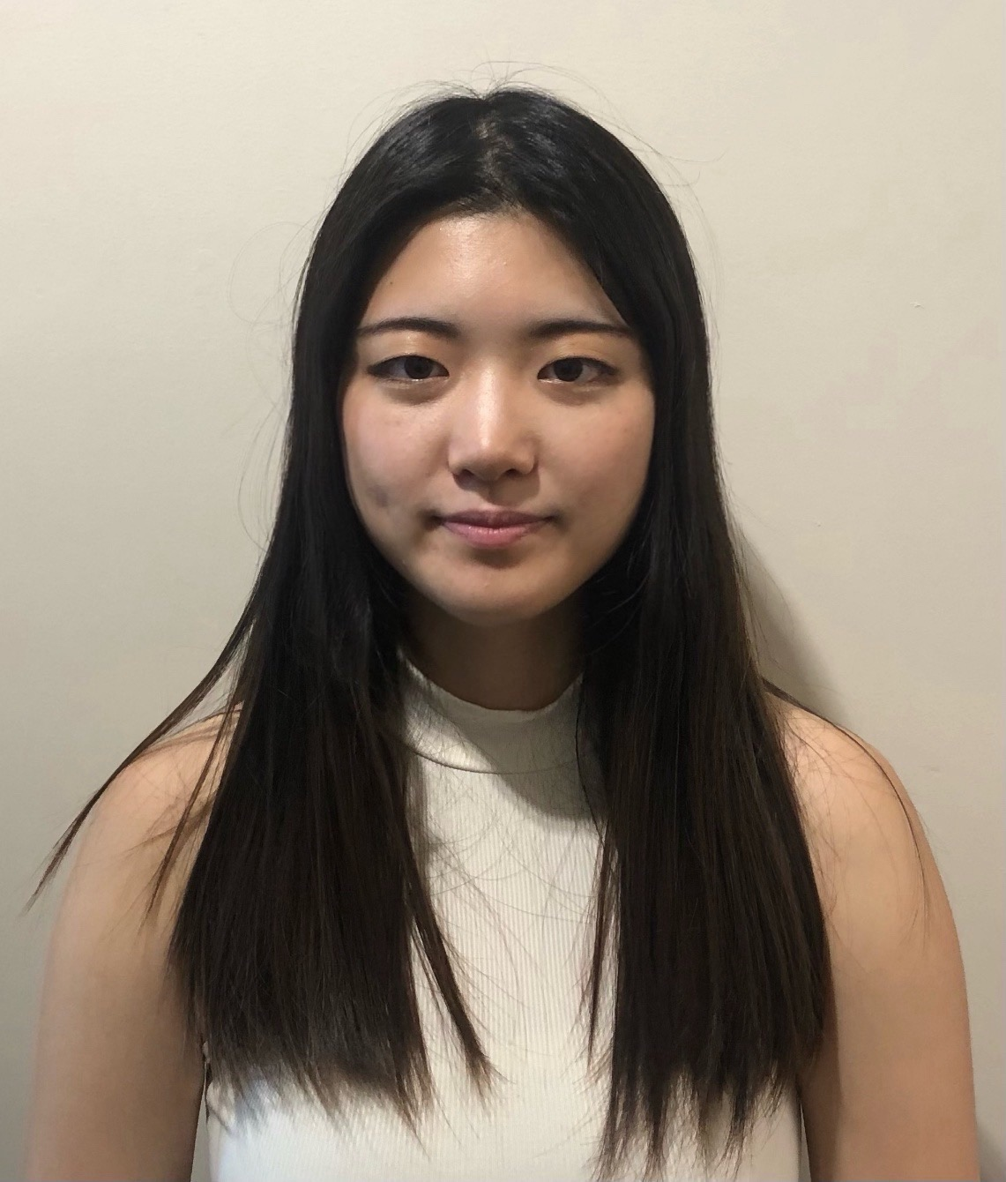



Meet the Team!
Ryan Takiff
Electrical Engineering
Suhyun Hwang
Photonic Science
Engineering
TJ Jones
Electrical Engineering
Daemy Luzardo
Electrical Engineering

Slide 3
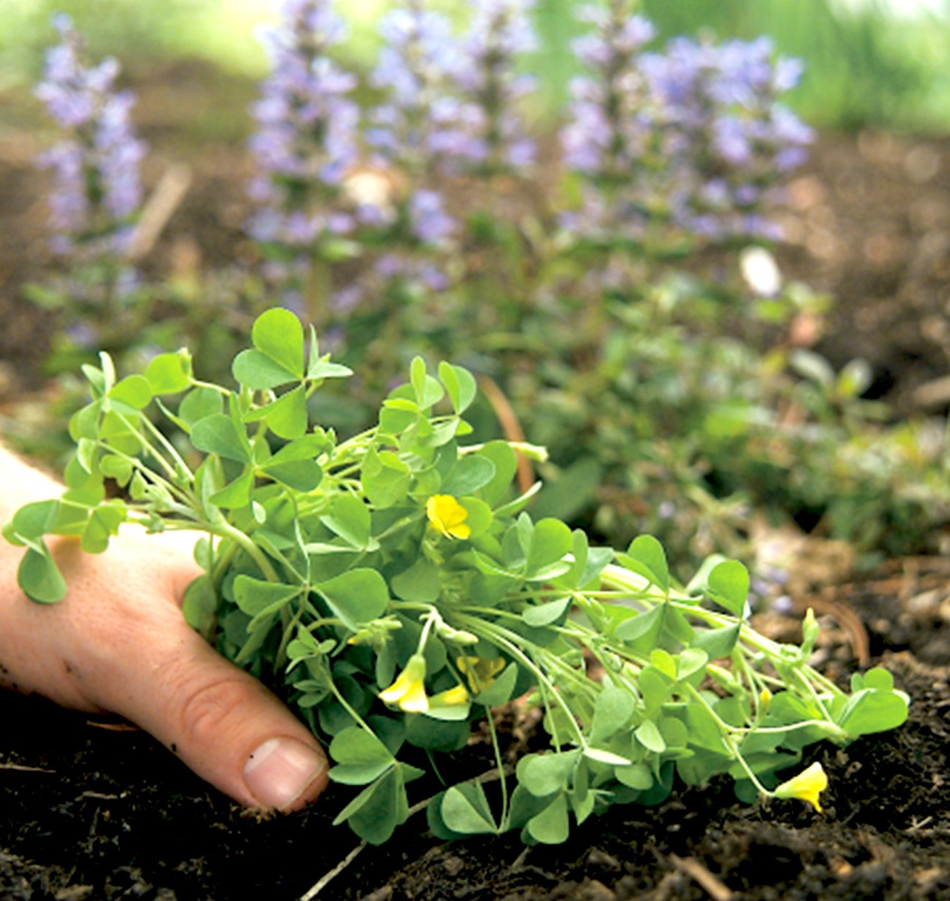
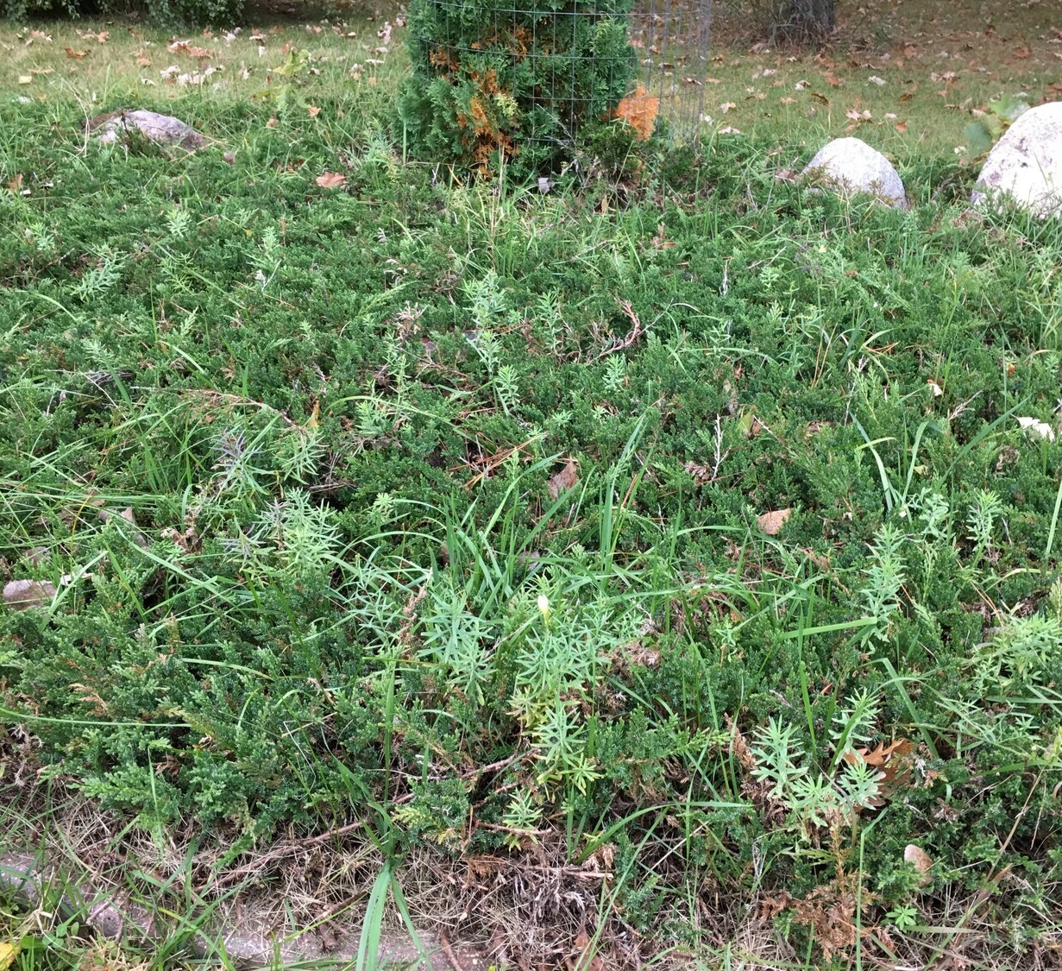
Motivation & Background
Why is weed control important?
Weeds compete with crops for essential nutrients in the soil
They absorb water from the soil
Weeds can overshadow crops, blocking sunlight that is necessary for photosynthesis
Many weeds serve as hosts for insect pests and other organisms that can harm crops

Slide 4

Motivation & Background
Use more cost-effective materials and components
Develop an echo-friendly method : evaporating the weeds (avoiding burning or spraying)
Mobile app integration for remote monitoring and control

Slide 5
Goals and Objectives
The main objective of our project was to build a robot capable of navigating a field or farmland.
Then the robot uses a guided laser system to remove unwanted weeds.
Providing farmers with a more environmentally friendly weed control method
Ryan, EE

Slide 6
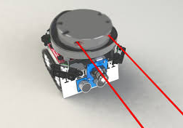
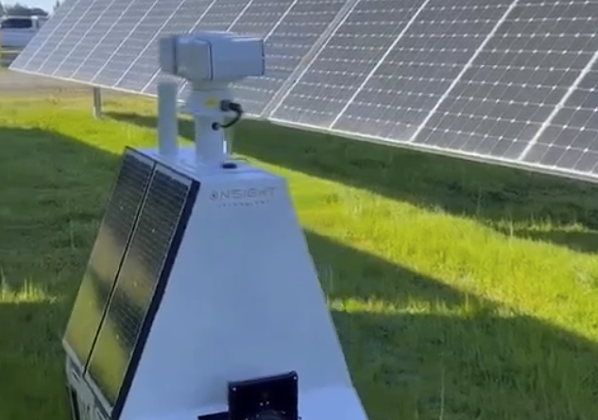
Robot Specific Objectives
Ryan, EE
Robot should be able to use the solar panels to charge its own batteries while out and operating.
Robot should be capable of basic autonomous navigation without getting stuck or lost.
Create a simple application to keep track of weed data as well as other important trackers.

Slide 7
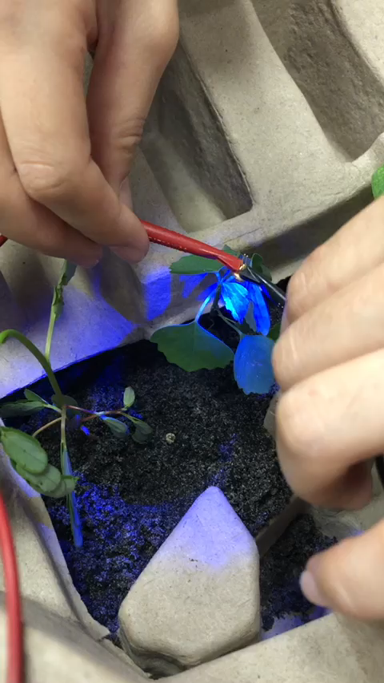
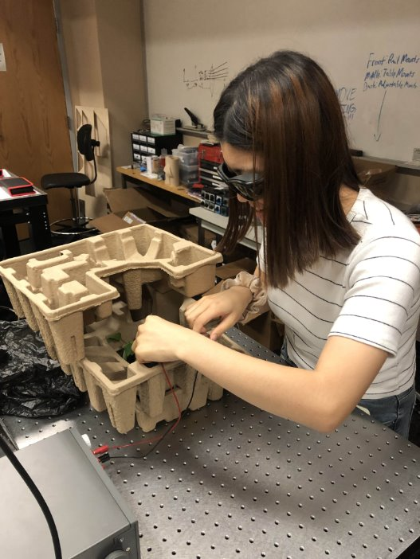
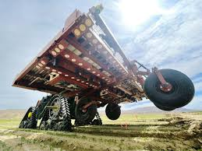
Laser System Objectives
Ryan, EE
Design a lightweight and compact laser control system for the robot, allowing for greater portability.
Achieve a high-power output from the laser diode, ensuring efficient moisture evaporation.
Integrate proper safety features to ensure safe operation around humans and other fragile objects.

Slide 8

Advanced Goals
Ryan, EE
Add a sufficient cooling system for all the electronics on board.
Create a 3D actively updated map model of the where the robot is along with its surroundings
Using SLAM localization for improved route planning, and greater adaptibility

Slide 9

Stretch Goals
Make the robot highly water resistant and create proper housing for each component and modify the chassis so that water does not penetrate the robot’s infrastructure
Application for the robot would let users monitor the progress of weed removal in their field and document weed location so the user would know where problem areas are located.
Use Slam Localization to fully automate all of the robot's functionality
Ryan, EE

Slide 10

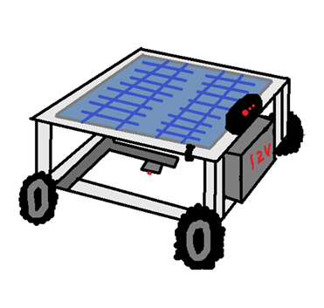
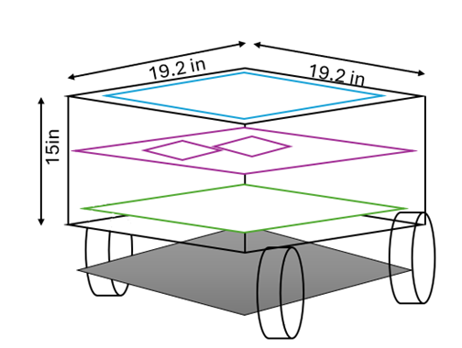

BEAM Description

Slide 11
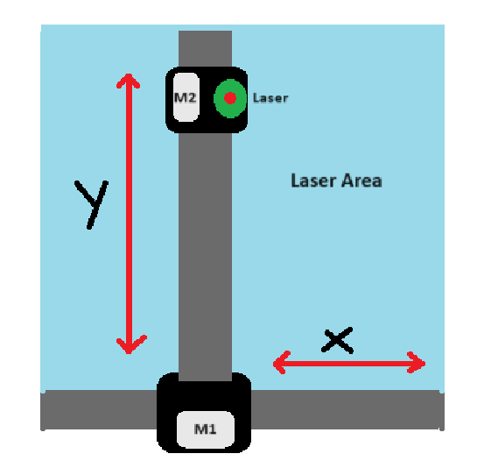
Laser Control System

Slide 12
Engineering Specifications
Chassis
Length x width x height | 1.6ft x 1.6ft x 1.25ft
Weight | ~60 lbs.
Material | Aluminum
Solar Panel
Maximum Power | 6 W
Maximum Voltage | 15 V
Battery
Maximum Lifespan | 10 h
Maximum Voltage | 12.8 V

Slide 13
Engineering Specifications Cont.
Laser Source
Wavelength Range | 450 – 550 nm
Optical Power | 1000 – 5500 mW
Laser System
Location accuracy | ≤ 1 cm
Weed Treatment
Treatment Time | 20 – 30 seconds
Treatment Distance (Laser Pointer End to Plant) | 5 – 10 cm
Weed Identification Efficiency | Expected at 70-85%

Slide 14
Hardware Comparison and Selection

Slide 15
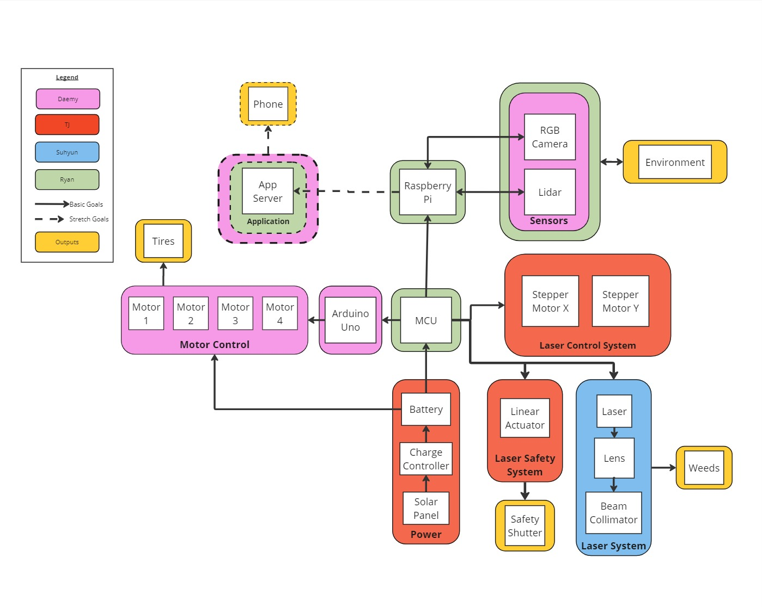
Hardware Block Diagram
TJ, EE
IDE

Slide 16
Battery Selection Lithium vs. Lead-acid
TJ, EE
Specs | LiFePO4 | Lead-Acid | Notes
Specific Energy (Watt Hours/kg) | 150-250 | 30-50 | LiFePO4 is lighter and packs more energy
Charge Time | 2-4 hrs | 8-16 hrs | LiFePO4 has quicker charge times
Cost (per kWh) | $100-300 | $150-200 | LiFePO4 tends to range higher than lead-acid, but some manufacturers offer similar prices

Slide 17
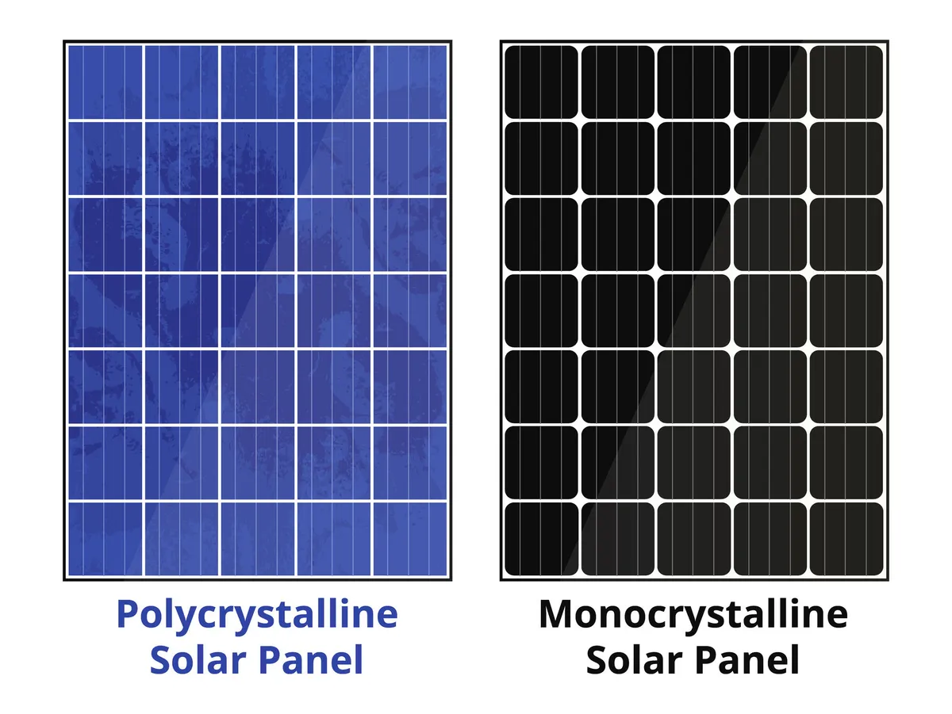
Solar Panel Selection Monocrystalline vs Polycrystalline
TJ, EE
Specs | Monocrystal | Polycrystal | Notes
Efficiency | ≥ 23% | ≤ 20% | Increased efficiency for monocrystal
Cost per Watt | $1-1.50 | $0.90-1.50 | Monocrystal tends to lean more expensive than polycrystal
*Temperature Performance | 0.38 - 0.44% | 0.44 - 0.50% | Increased performance in outdoor temperatures for monocrystal
*Lower Temperature performance is better!

Slide 18
Charge Controller Selection Main functions: - Supply adequate voltage for battery charging - Regulate charging current - Prevent battery overcharge
TJ, EE
Specs | MPPT | PWM | Notes
Voltage Compatibility | Wide range of voltages | Fixed voltage | MPPT offers more precise voltage control for LiFePO4 batteries than PWM
Efficiency | 95-99% | 70-85% | MPPT offers more power efficiency
Cost | $25-40 | $12-30 | While MPPT is typically more expensive, they also offer better efficiency and precision

Slide 19
Charge Controller Selection
Bateria Powers' MPPT Solar Charge Controller
Voltset's MPPT Solar Charge Controller
TJ, EE
Specs | Ratings
Voltage Input | 15 to 30V
Current Output | 10A
Weight | 0.32lbs
Cost | $36.99
Specs | Ratings
Voltage Input | ≤ 30V
Current Output | 10A
Weight | 0.375lbs
Cost | $39.99

Slide 20
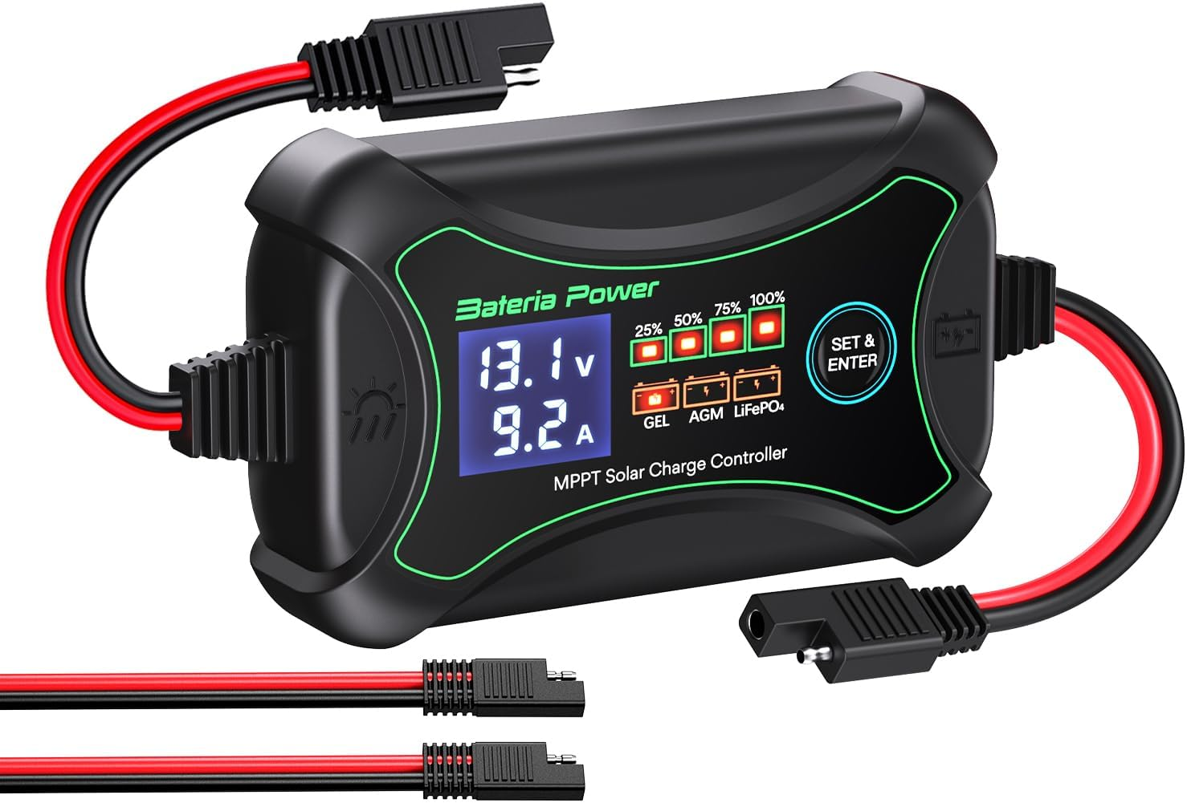
Charge Controller Selection
Bateria Powers' MPPT Solar Charge Controller
TJ, EE
Specs | Ratings
Voltage Input | 15 to 30V
Current Output | 10A
Weight | 0.32lbs
Cost | $36.99

Slide 21
Voltage Regulator Selection: Switching Regulators vs Linear Regulators Main function: Step down 12V to 5V/3.3V for powering electronics
Specs | Switching Regulator | Linear Regulator | Notes
Load Efficiency | 65-80% | 15-20% | Increased efficiency reduces power loss and heat generated
Circuit Design Complexity | 6-11 Components | 3-5 Components | Switching regulator is more complex, yet needs less board space due to less power loss
Cost | $5-15 | $2-5 | Switching regulator has increased cost and more components, but better performance
TJ, EE

Slide 22
Switching Regulator Selection
TJ, EE
Texas Instrument's TSP40200
Texas Instrument's MC34063ADR
Specs | Ratings | Notes
Voltage Input | 3 to 40 V | Sufficient
Voltage Output | 1.25 to 40V | Sufficient
Max Current Out | 1.5A | Less than required Iout
Power Efficiency | ≤ 87.7% | Slightly lower efficiency
Specs | Ratings | Notes
Voltage Input | 4.5 to 52 V | Sufficient
Voltage Output | 0.7 to (Vin-10V) | Sufficient
Max Current Out | 3A | Sufficient
Power Efficiency | ≤ 94% | Higher efficiency

Slide 23
MCU Selection Main functions: - Decision making - Manage and execute multiple tasks - Collect, process, and transmit data between devices
Specs | ESP32-WROOM | Arduino LoRa | Notes
Microcontroller | Dual-core 240 MHz | ARM Cortex M0+ | ESP has higher performance and computational capacity
Clock speed | 240 MHz | 48 MHz | ESP clock speed is 5 times faster
Flash Memory | 4 MB | 256 KB | ESP has over 3MB more space
GPIO Pins | 34 | 22 | ESP has more GPIO pins, which are essential for BEAM
Analog Inputs | 18 | 7 | ESP more than doubles analog inputs
Price | ~$4.34 USD | ~$35-40 USD | ESP is more cost-efficient for most IoT projects
Size | 18mm x 25.5mm | 25mm x 45mm | ESP is more compact
Manufacturer | Espressif Systems | Arduino (LoRa by Semtech)
Ryan, EE
Specs | ESP32WROOM | Arduino LoRA | Notes
Microcontroller | Dual-core 240 MHZ | ARM Cortex M0+ | ESP has higher performance and computational capacity
Clock speed | 240 MHZ | 48 MHz | ESP clock speed is 5 times faster
Flash Memory | 4 MB | 256 KB | ESP has over 3MB more space
GPIO Pins | 34 | 22 | ESP has more GPIO pins, which are essential for BEAM
Analog Inputs | 18 | 7 | ESP more than doubles inputs

Slide 24
Raspberry Pi 4B Main functions: - Object recognition - Board to board communication protocols (I2C, UART, WiFi) - parallel processing real-time data
Feature | Arduino MKR WAN 1300 | Franzininho Board | Raspberry Pi 4 Model B
Microcontroller | ARM Cortex-M0+ | ATtiny84 | Broadcom BCM2711 (Quad-core Cortex-A72)
Clock Speed | 48 MHz | 20 MHz | 1.5 GHz
Flash Memory | 256 KB | 8 KB | microSD (Expandable)
SRAM | 32 KB | 512 B | 2/4/8 GB LPDDR4
GPIO Pins | 22 | 12 | 40
Analog Inputs | 7 | 8 | -
Digital I/O Pins | 22 | 12 | 40
WiFi | No (LoRa connectivity) | No | Yes
Price | ~$39 USD | ~$10-15 USD | ~$35-55 USD
Size | 2.7" x 1" (68.6mm x 25.4mm) | 29mm x 13mm | 85.6mm x 56.5mm
Manufacturer | Arduino | Franzininho Project | Raspberry Pi Foundation
Notes for BEAM | Good for low-power wireless communication | Compact but lacks advanced features | High computational power for BEAM Requirements
Ryan, EE

Slide 25
Motor Type Selection
Specs | Brushed DC Motor | Stepper Motor | Notes
Torque | High | Low | The selected Torque for stepper motors must be precise.
Motor Speed Control | PWM | Counts number of steps | DC motors have a simple speed motor control, but SM are more precise
Maintenance | High | Low | DC motor brushes wear over time
Cost | $10-50 | $15-100 | Dc Motors have lower initial cost
Daemy, EE

Slide 26
DC Motor Selection Main functions: - Powering the robot's wheels - Traversing rough terrain
Specs | RS550 | Mabuchi 555SH | Notes
Operating Voltage | 5-15 V | 12V | Both can operate within a range but 12V was chosen
Rated Torque | 265 g.cm | 420 g.cm | Torque can be improved with a gear box
Rated Current | ≤2A | 1.5A | Can vary depending on the speed and runtime
Speed | 4000 RPM | 5100 RPM | Speed was not the main concern
Weight | 150 g | 200 g | Less weight helps with speed
Cost | $16-20 | $18-25 | The difference wasn’t significant
Daemy, EE

Slide 27
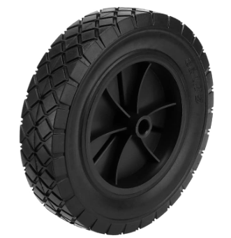
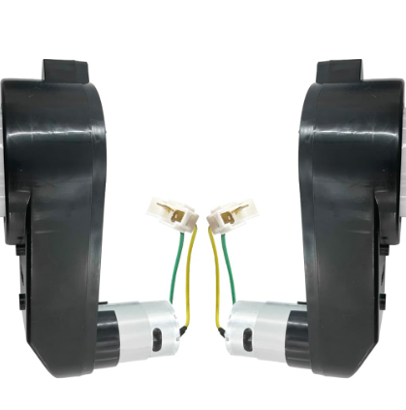
Transmission and Tire Selection
Daemy, EE
Speed upgraded to 40000 RPM.
Gearbox composed of three gears; the middle one is metal.
All terrain wheels were chosen to navigate outdoors.
Wheels’ materials are rubber and plastic.
8-inch diameter.

Slide 28
Motor Driver Selection Main functions: - Powering the DC motors
Specs | BTS 7960B | TB67H420FTG | Notes
Supply Voltage limit | 45 V | 50 V | Has no impact to selection due to high limit
Quantity needed for navigation | 8 | 2 | Corresponds to bidirectional functionality
Size | 9.9mm x 14.9 mm | 7mm x 7mm | Bigger dimensions help with soldering
Path Resistance | 18 mΩ | 0.33Ω | A lower path resistance is wanted
Current limit | 43A | 9A | Higher current limitation is wanted to prevent damaged to IC
Price | ~1 | ~$5 | The total price for the BTS7960B would be lower despite the difference in quantity
Daemy, EE

Slide 29
Hardware Block Diagram
TJ, EE
Peripheral Components
IDE
Peripheral Components

Slide 30
Peripheral Components
TJ, EE
Raspberry Pi 4 Camera
An RGB camera that sends image data to Raspberry Pi for weed detection and location
LIDAR​
​
Robot navigation and obstacle detection​
Communicates distance data with ESP32 for obstacle detection and area recognition
Linear Actuator​
Uses a 12v DC motor to lower safety shutter for laser protection

Slide 31
Sensor Selection: Sonar vs Lidar Main function: Robot navigation and obstacle detection
Specs | Lidar | Sonar
Detection Medium | Light | Sound
Range | Can be up to 200m | Can be up to 50m
Accuracy | mm range | cm range
Speed | Faster data acquisition | Slower data acquisition
Environment | Sensitive to weather conditions | Works well in low visibility
Applications | 3D Mapping/Autonomous vehicles | Object detection and depth sensing
TJ, EE

Slide 32
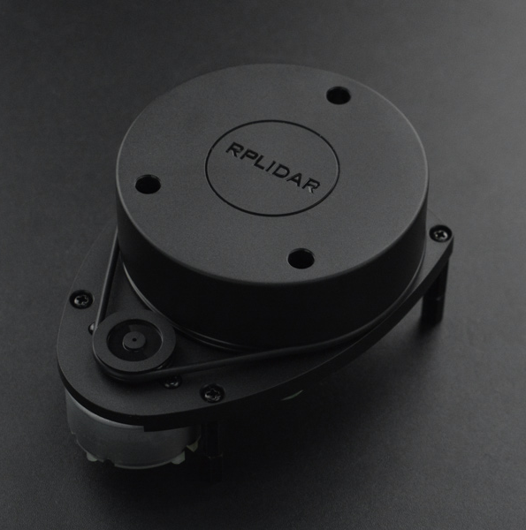
RPLIDAR A1 by SLAMTECH
360-degree scan with 12-meter range
Produces 2D point cloud data that can be used in mapping, modeling, and localization
Can function well in indoor and outdoor settings and without direct sunlight exposure
Connects via USB
TJ, EE

Slide 33
Camera Selection: USB vs CSI Camera Main function: Object identification
Specs | CSI Camera | USB Camera
Connection | Camera Serial Interface | USB
Image Quality | Made specifically for Raspberry Pi, typically high | Moderate to high
Latency | Lower latency due to CSI connection | Higher latency because of USB overhead
Power Consumption | Low, powered directly from board | Depends on model
TJ, EE

Slide 34
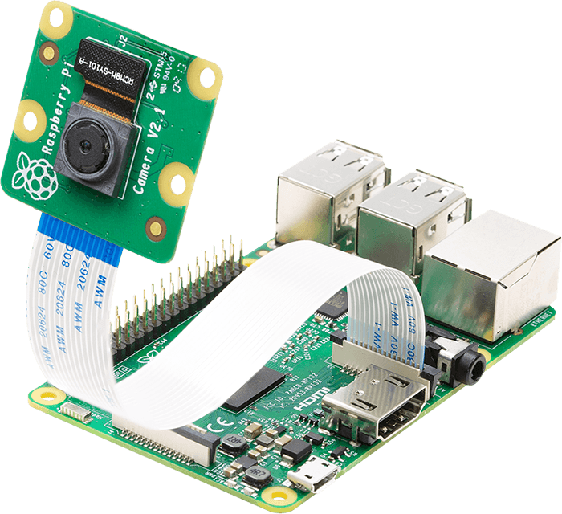
Raspberry Pi Camera V2.1 by Raspberry Pi Ltd.
8 megapixel Sony IMX219 image sensor
3280 x 2464 pixel static images
Supports 1080p30, 720p60, and 640x480p90 video
Provides enough quality for object detection
Interfaces directly with Raspberry Pi 4
TJ, EE

Slide 35
Safety Shield Mechanism Selection: Linear actuator vs Motorized Pulley Main function: Lowers safety shielding before laser use
Specs | Linear Actuator | Motorized Pulley
Precision | High precision for positioning | Moderate precision, varies with tension
Speed | Typically slower | Can be faster with motor choice
Complexity | Compact and self-contained | More complex: needs motors, pulley, cables, etc
TJ, EE

Slide 36
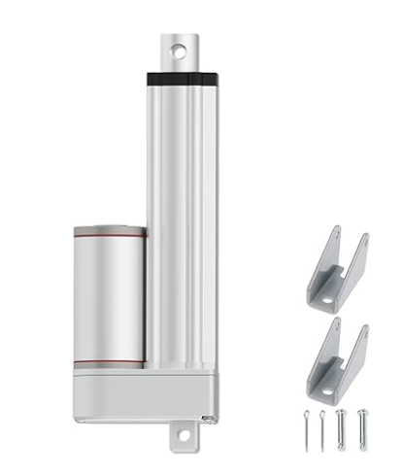
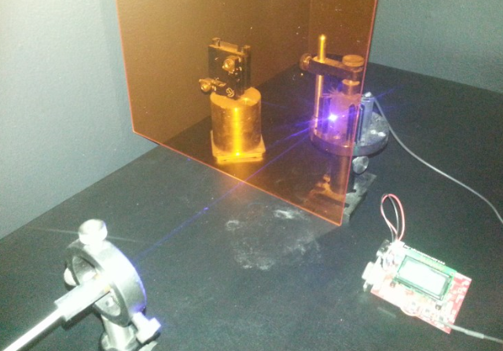
Linear Actuator
12v Volt-Electric Linear Motor Actuator
Quiet operation, waterproof, can move 220 lbs 0.47"/sec
Will lower the safety shutter made of 250nm to 520nm Laser Shielding obtained from J Tech Photonics, Inc.
Shielding is an optical grade semi-transparent acrylic material that has been tested with 405nm and 445nm lasers to show an OD of 3+
TJ, EE

Slide 37
Software Comparison & Selection
ESP32 WROOM
 | PlatformIO | Arduino IDE | MicroPython | Notes
Language | Python | C++ | Python | C++ is faster than Python
Performance | High | Medium | Low | Depends on libraries used and the project
Experience Required | Advanced | Beginner | Beginner | PlatformIO is used for more complex embedded projects
ESP-IDF | Yes | No | Yes | It’s the official framework for the ESP32

Slide 38
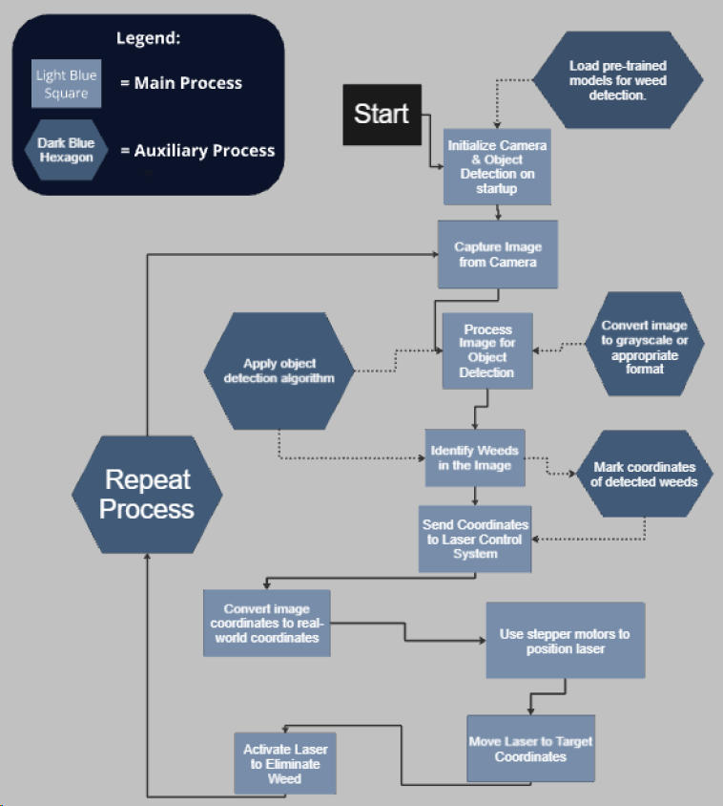
Raspberry Pi Object Detection

Slide 39
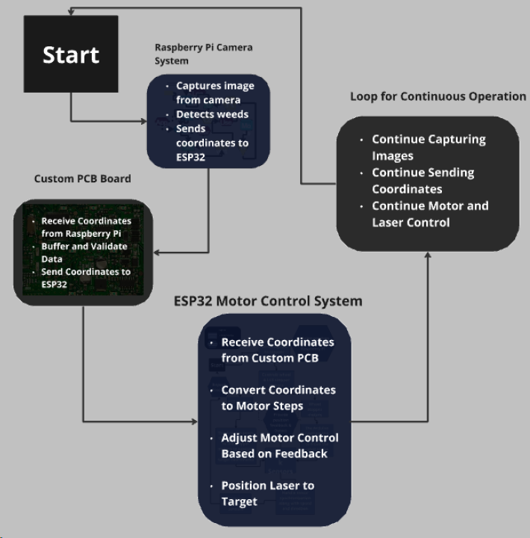

MCU to PCB

Slide 40
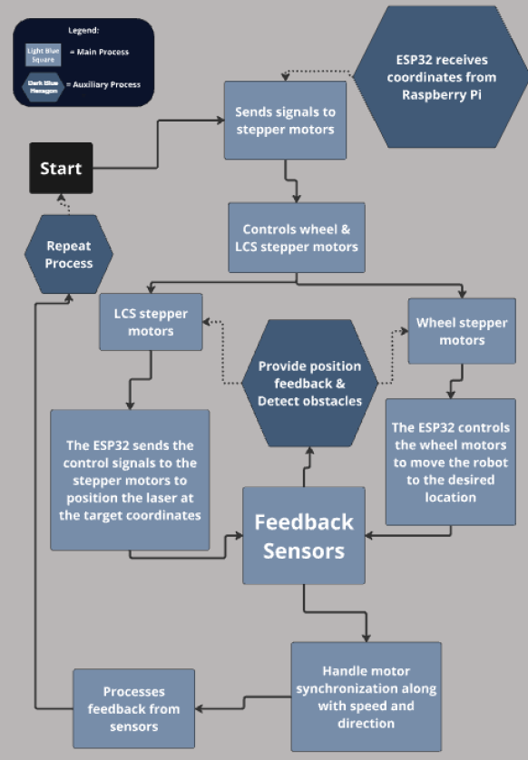
ESP32 Motor Control

Slide 41
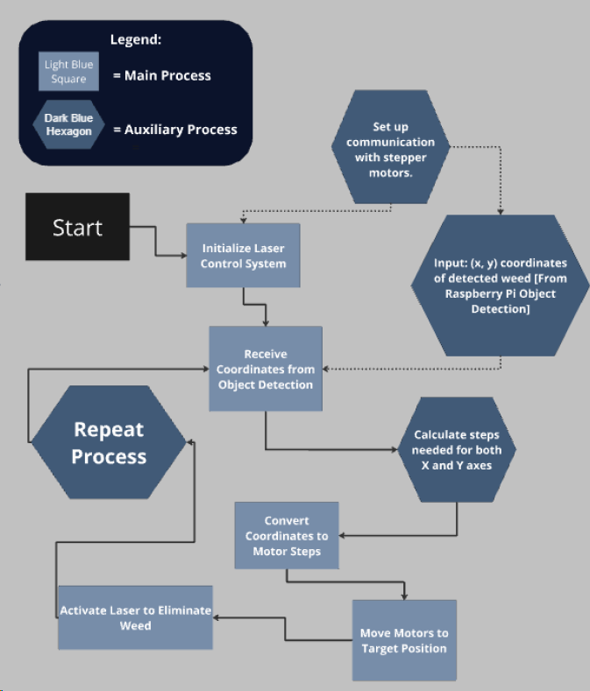
Laser Control System

Slide 42
Laser Design Hardware
 | LEDs | Laser Diodes
Particle Phase | Incoherent | Coherent
Direction | Random | Linear
Output Power | 10 – 50 µW | 1 – 1000 mW
Rise Time | 1 to 100 ns | < 1 to 10 ns
Temperature Effects | Increases wavelength by .6 nm/ °C | Wavelength varies by .25 nm/ °C Threshold current rises by .5mA/ °C
Laser Diodes
Easy to achieve higher intensities
Have narrower beam

Slide 43
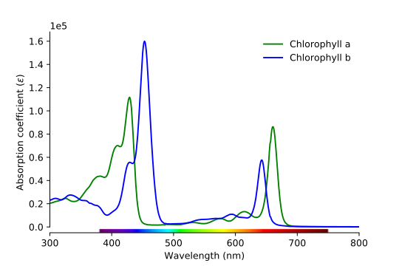
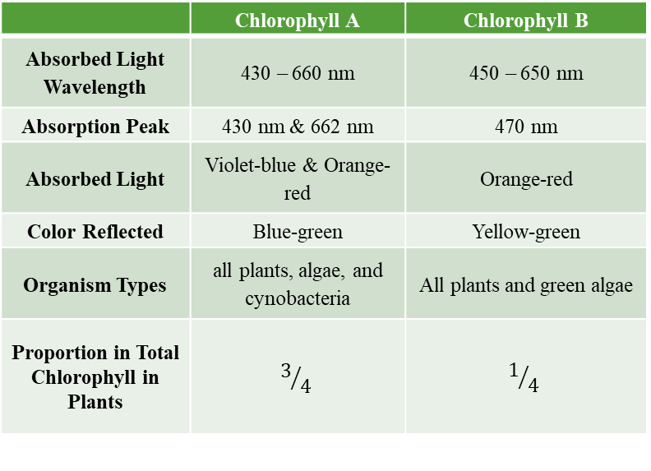
Laser Design Hardware
 | Chlorophyll A | Chlorophyll B
Absorbed Light Wavelength | 430 – 660 nm | 450 – 650 nm
Absorption Peak | 430 nm & 662 nm | 470 nm
Absorbed Light | Violet-blue & Orange-red | Orange-red
Color Reflected | Blue-green | Yellow-green
Organism Types | all plants, algae, and cynobacteria | All plants and green algae
Proportion in Total Chlorophyll in Plants | $$3/4$$ | $$1/4$$
Laser Color for Treatment : Blue & Red

Slide 44
Laser Design Hardware
Laser Diode
Color | Wavelength | Power
Blue | 465 nm | 1-2 W
Red | 638 nm | 1-2 W
Lens
 | Type | Material | Wavelngth | Focal Length | Effective Focal Length | Dimension | Thickness
G8 | Aspheric | Glass | 400 – 700 nm | 7 mm | 8 mm | M9 X 0.5 | 2.3 mm

Slide 45
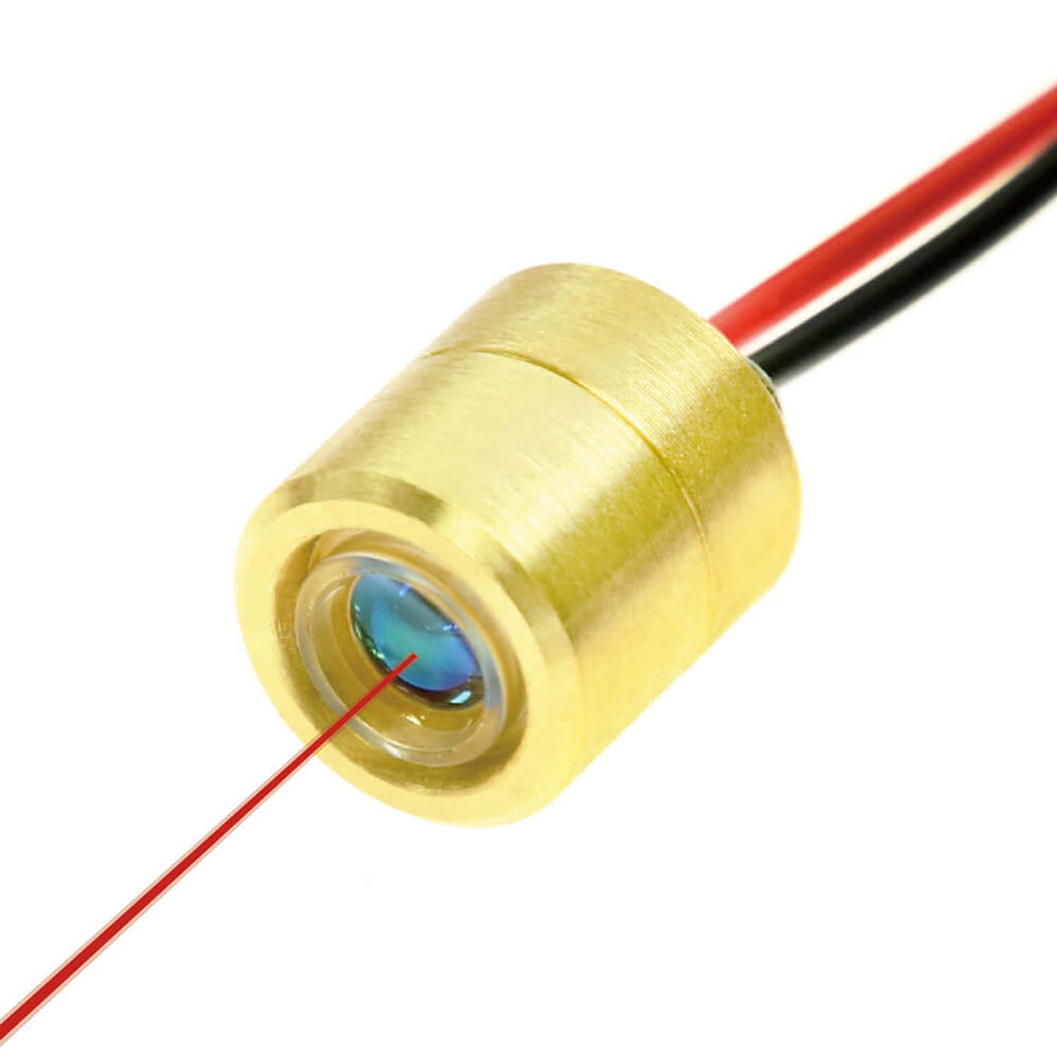
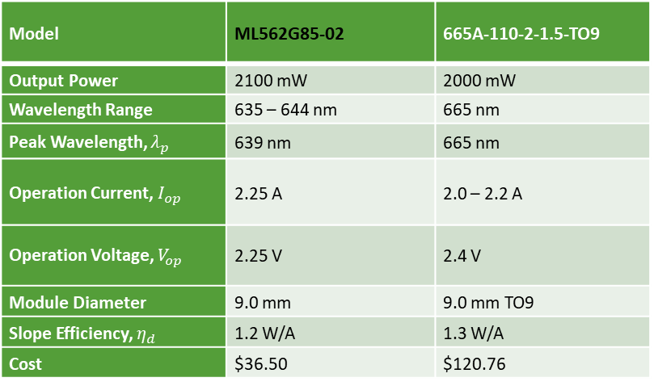
Laser Design Hardware
Red Laser Diode
Model | ML562G85-02 | 665A-110-2-1.5-TO9
Output Power | 2100 mW | 2000 mW
Wavelength Range | 635 – 644 nm | 665 nm
Peak Wavelength, $λ_{p}$ | 639 nm | 665 nm
Operation Current, $I_{op}$ | 2.25 A | 2.0 – 2.2 A
Operation Voltage, $V_{op}$ | 2.25 V | 2.4 V
Module Diameter | 9.0 mm | 9.0 mm TO9
Slope Efficiency, $η_{d}$ | 1.2 W/A | 1.3 W/A
Cost | $36.50 | $120.76

Slide 46
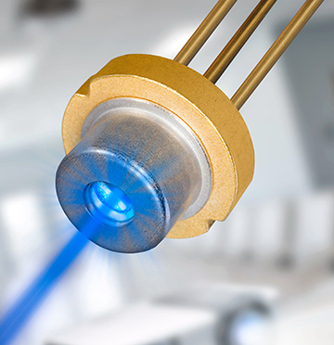
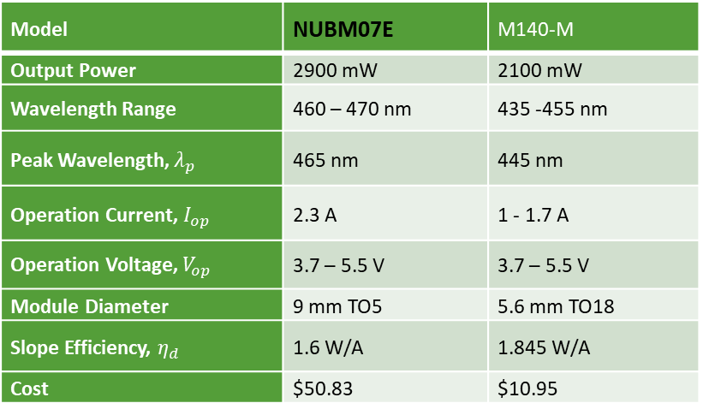
Laser Design Hardware
Blue Laser Diode
Model | NUBM07E | M140-M
Output Power | 2900 mW | 2100 mW
Wavelength Range | 460 – 470 nm | 435 -455 nm
Peak Wavelength, $λ_{p}$ | 465 nm | 445 nm
Operation Current, $I_{op}$ | 2.3 A | 1 - 1.7 A
Operation Voltage, $V_{op}$ | 3.7 – 5.5 V | 3.7 – 5.5 V
Module Diameter | 9 mm TO5 | 5.6 mm TO18
Slope Efficiency, $η_{d}$ | 1.6 W/A | 1.845 W/A
Cost | $50.83 | $10.95

Slide 47
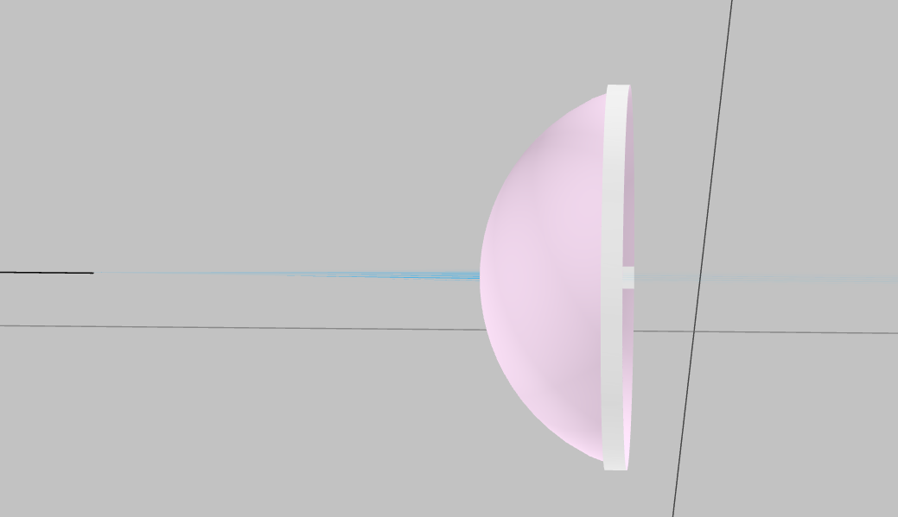
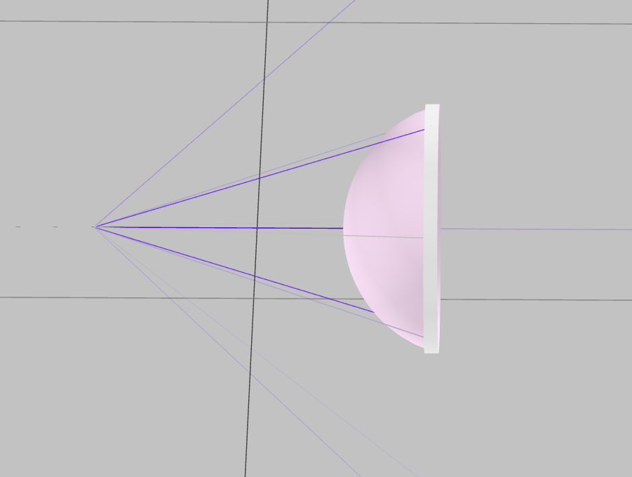
Laser Design Hardware
Maximum Beam Divergence
 | NUBM07E | M140-M
Parallel (°) | 0.55 | 14
Perpendicular (°) | 0.8 | 44

Slide 48
Laser Design Hardware
Laser
Intensity
Power
Spot Size
Collimating Lens
Treatment
Working Distnace > 1 cm
Duration 30-60 sec
Focus Lens
Plants

Slide 49

PCB Design

Slide 50
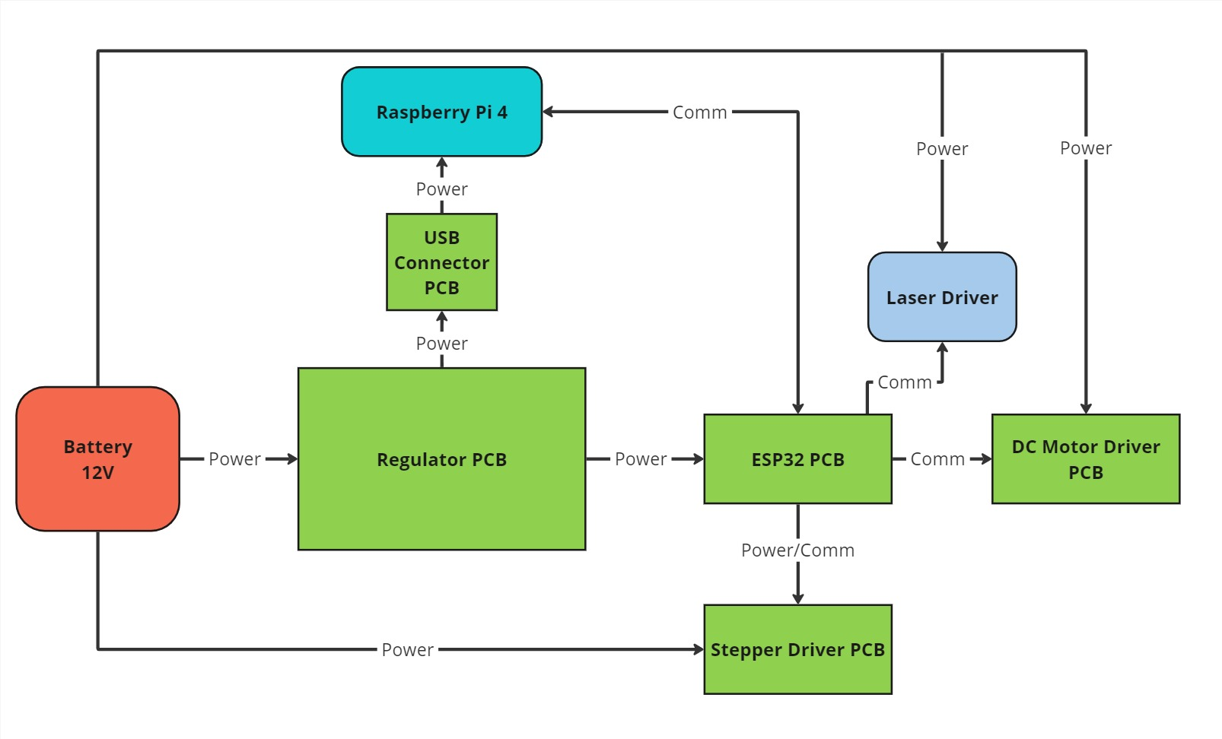
PCB Flow Chart
TJ, EE

Slide 51
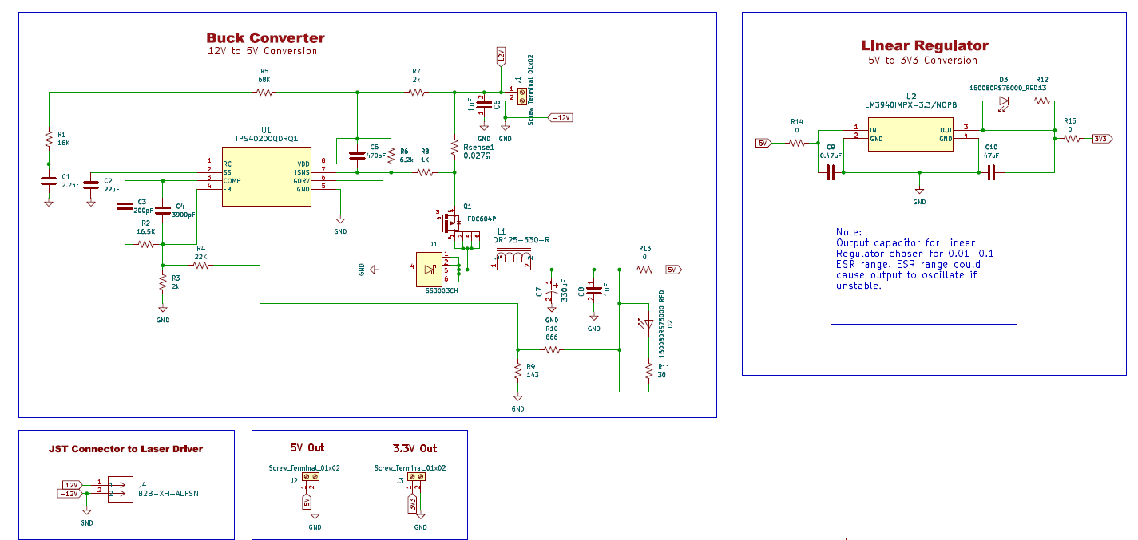
Regulator Circuit
TJ, EE

Slide 52
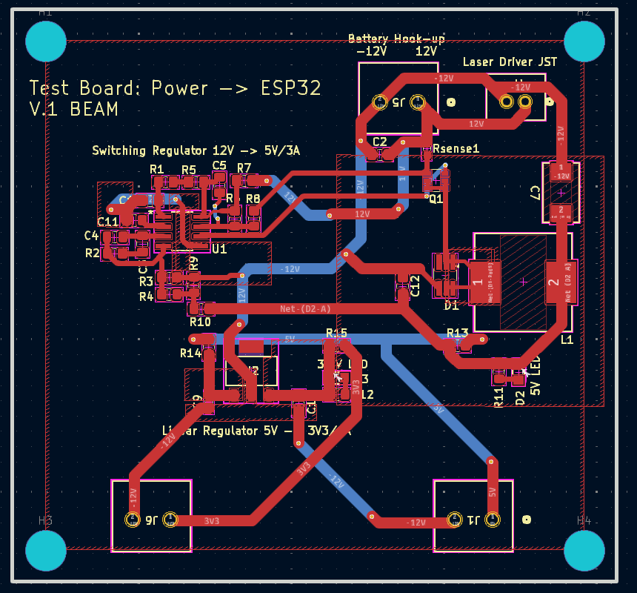
Features:
Terminal blocks for breadboard testing
GND planes for heat dissipation
M5 Mounting holes
TJ, EE

Slide 53
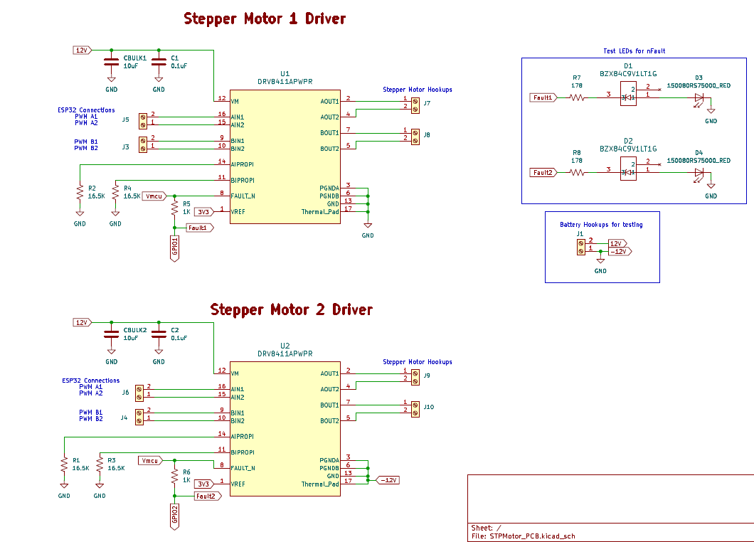
TJ, EE

Slide 54
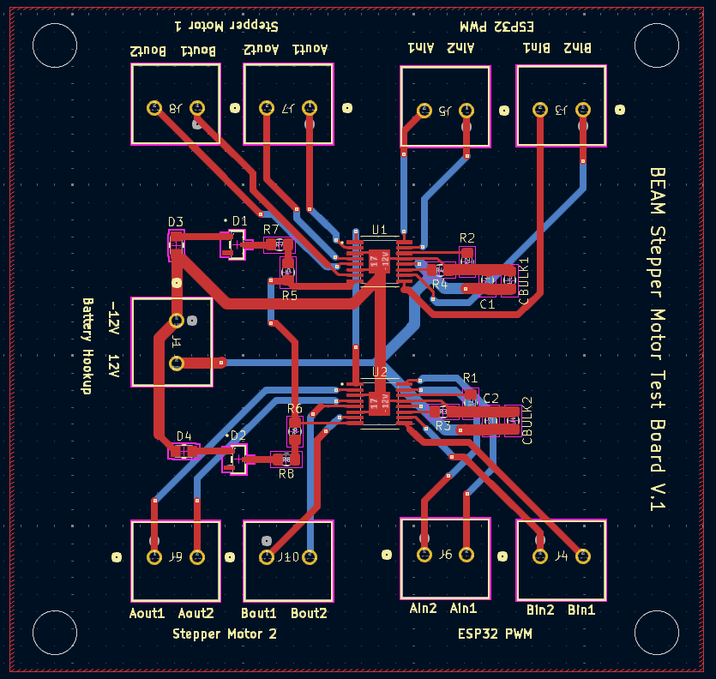
TJ, EE

Slide 55
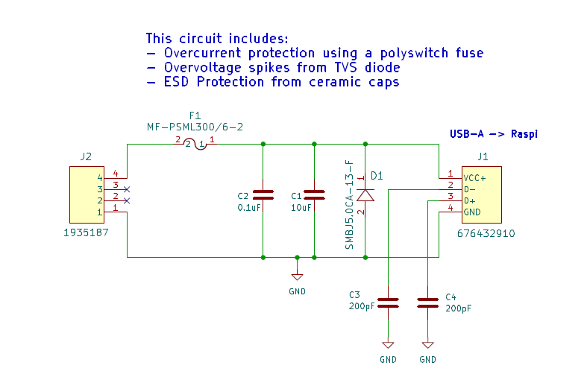
TJ, EE

Slide 56
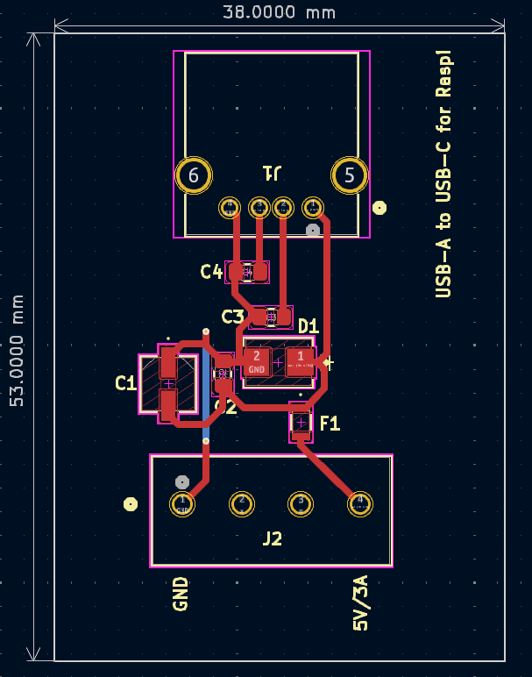
TJ, EE

Slide 57
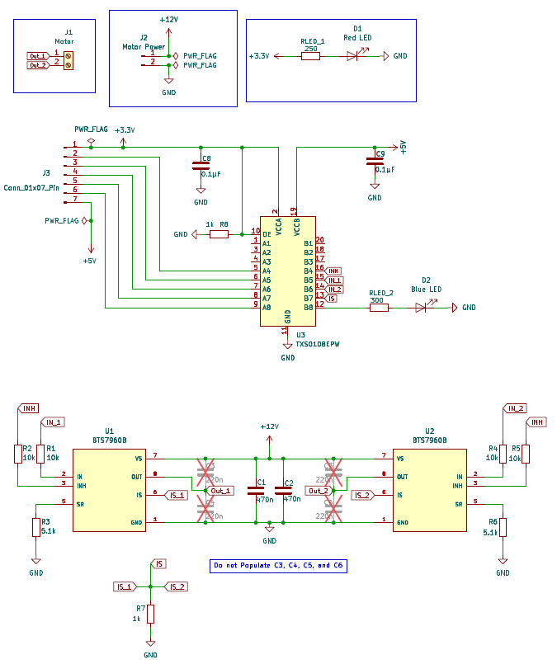
Daemy, EE

Slide 58
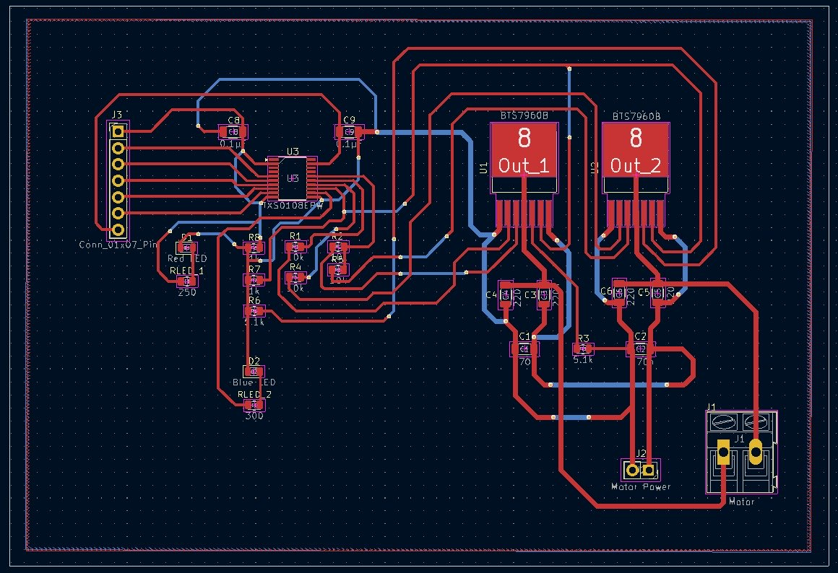
Daemy, EE

Slide 59
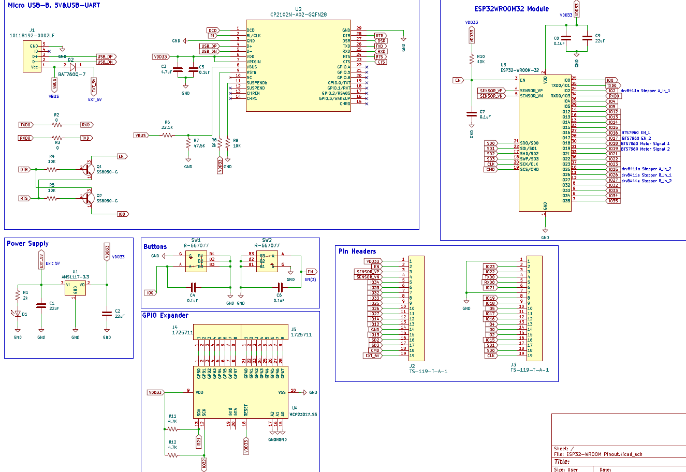
Ryan, EE

Slide 60
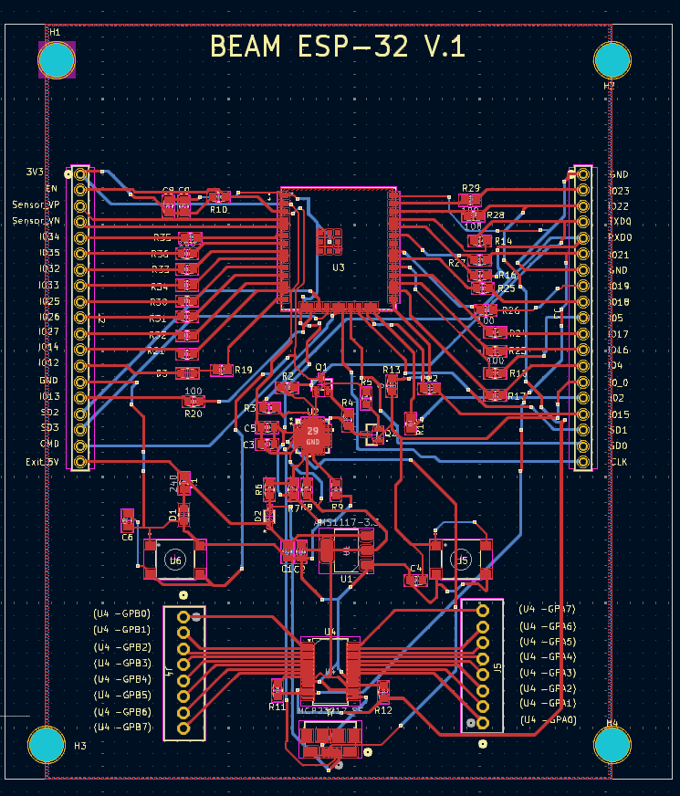
GND planes for heat dissipation
M5 Mounting holes
Silkscreen Layer and VIAs used for proper labeling and functionality
Ryan, EE

Slide 61
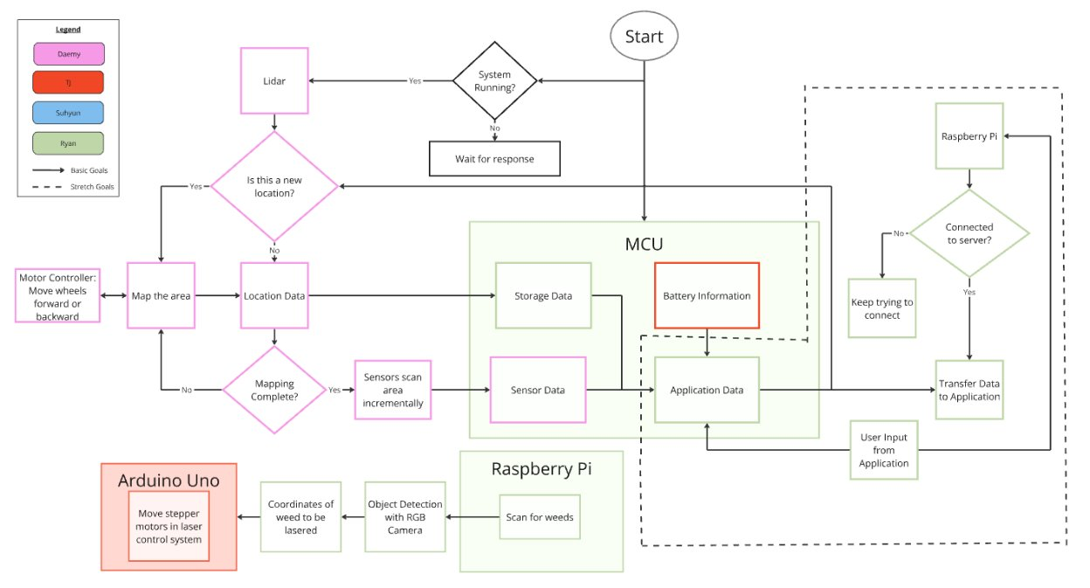
Software Design
Ryan, EE
This system will be broken down into required components for readability

Slide 62
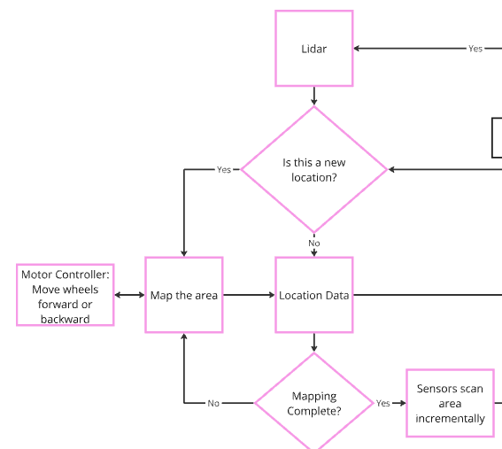
Lidar
Ryan, EE
While the system is active, the Lidar is tasked with continually determining if and how much the robot has moved at any given time
The Lidar is then tasked with storing the location data, and instructing the motors to move if necessary
The Lidar uses the location data to continue to map out the area, using feedback loops to continuously iterate the process

Slide 63
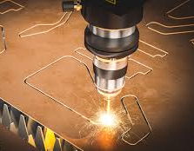
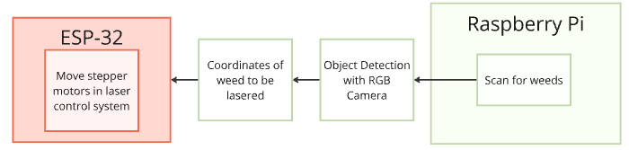
Software Design – Laser Control System
A camera feed from the Raspberry Pi will be constantly supplied to the ESP-32-WROOM
The ESP-32 will move the laser control system's stepper motors to the correct determined location of the weed
The robot will stop to adjust the laser, then which a shield enclosed laser module will lower to designated area and activate.
This process is ran continuously until there are no more weeds detectable by the raspberry pi
Ryan, EE

Slide 64
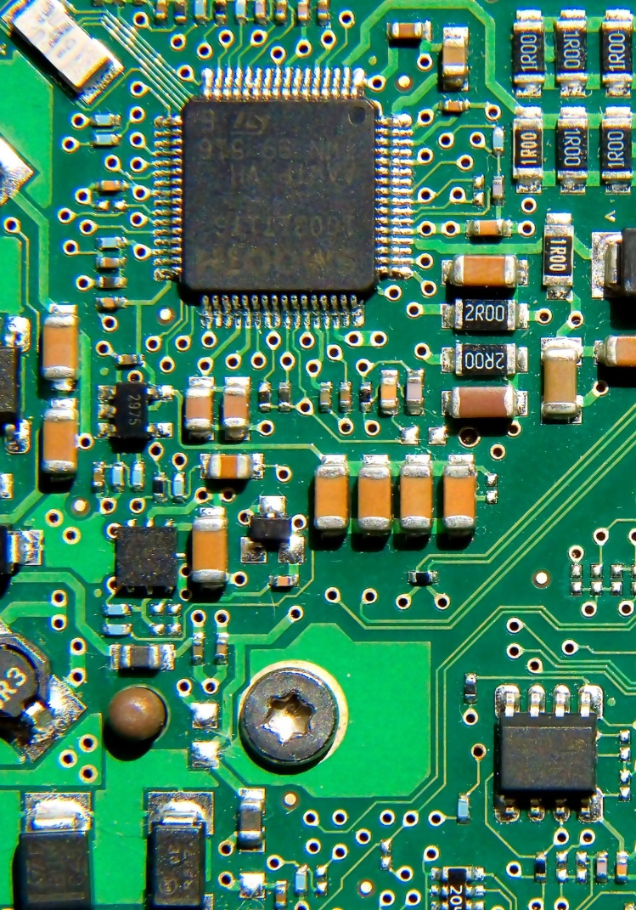
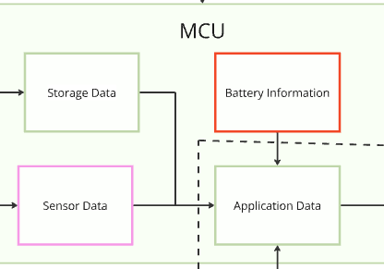
Software Design – MCU
Ryan, EE
The MCU (Consisting of an ESP-32 and Raspberry Pi 4) is the middle man and bridge for the entirety of the robot's systems
The MCU is required to keep track of the battery, as well as the solar charging system to keep itself powered
The MCU is responsible for tracking storage and sensor data, as well as returning that info to the application

Slide 65
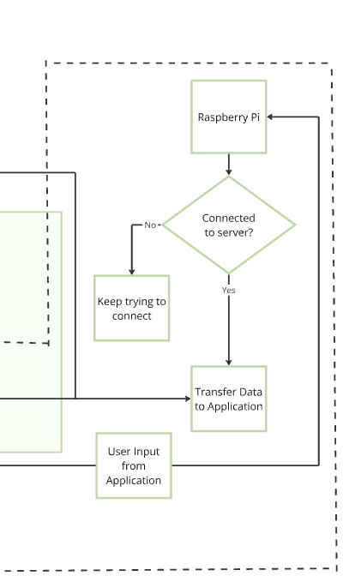
Software Design – Stretch Goals
Ryan, EE
Ideally as a stretch goal we wanted to give the application much more attention.
The application would be able to not only monitor the robots current weeding process, but take remote control and or call back the robot if needed.
The application would be connected to an external server, allowing for fast and secure data uploading and integration after every session, giving the most accurate and helpful data in a way that is easy to understand

Slide 66
Software Design
Ryan, EE

Slide 67

Hardware & Software Testing
Ryan, EE
Our Hardware Testing comprised of us testing our various PCBs on breadboards as this was one of the fastest ways to confirm our intended functionality
We used the System On Chip (SOC) microcontrollers in order to properly test our designs, including ESP-32-WROOM
Our Software testing consists of us program our microcontrollers and motor circuits in order to test their proper functionality using the Arduino IDE

Slide 68

Performance Evaluation
Ryan, EE
We take careful consideration in evaluating each of our parts are the correct choice for its purpose and that it will function as we intend it to
Our PCB designs were cleared by our advisors, so we are confident once everything is wired, tested, and revised for needed issues, the robot should perform as we intend
Additionally tests will be done to confirm the performance of the laser driver circuit and laser diode by our PSE member to ensure the proper functionality within the context of our goals and objectives

Slide 69

Problems and proposed solutions
Problem | Solution
Issues with hardware while testing designs. | Continue testing and troubleshooting hardware to resolve issues.
Difficulty with software and coding due to lack of formal coding training and a dedicated coder, slowing progress. | Work diligently as a team to develop programs and use all available resources to improve software progress.
Ryan, EE

Slide 70
Prototyping & Testing
Hardware & Software Testing
Performance Evaluation
Success
Difficulty, problem and proposed solution

Slide 71
Administrative Content

Slide 72
Budget
Item | Description | Total Cost
Hardware | Chassis, sensors, DC motors | $273
 | Solar Panel | $50
Laser Control System | Stepper motors and drivers, timing pulley | $100
Laser System | Diodes, Driver Board | $282
PCB | Boards, ICs, resistors, capacitors, etc | $160
Total |  | $865
Daemy, EE
Notes:
Add manufacturer

Slide 73
BOM
Item | Quantity | Price
PCB
BTS7960B | 15 | 20.31
JLCPCB | 25 | 40.39
Digikey | 1 | 227.38
 | Total | $288.08
Item | Quantity | Price
Peripherals
Raspberry Pi B | 1 | 65.76
Pi Camera Module V2 | 1 | 14.99
Lidar | 1 | 100
Linear Actuator 5.9'' | 1 | 26.99
 | Total | $207.74
Frame
Rail | 19 | 37.66
Screws & nuts | 4 | 80.43
Mounting Plate | 2 | 6.46
 | Total | $124.55
Daemy, EE
Laser Control System
Cable Wrap | 2 | 11.98
Pulley & Belt | 15 | 27.93
Gantry | 2 | 18.22
Stepper Motor | 2 | 35.96
 | Total | $94.09
Hardware
DC Motor Transmission | 4 | 57.32
Wheels | 4 | 25.55
Chargers | 2 | 67.81
Shipping |  | 30.7
Solar Panel | 1 | 45
Battery | 1 | 91.05
Board Driver | 1 | 8.99
Cables | 2 | 20
Fuses | 1 | 5
Fuse Holder | 1 | 5.31
 | Total | $356.73
Total
$1449.26
Laser System
Board Driver | 3 | 76.62
Diode Housing | 2 | $29.70
Diode | 2 | 23.93
Blue Diode | 5 | 146.9
Red Diode | 2 | 100.92
 | Total | $378.07
Notes:
Add manufacturer

Slide 74
Work Distribution
Student | Main Tasks | Secondary Tasks
TJ Jones | Stepper Motor Driver Schematic and PCB Design | MCU Schematic and PCB Design
TJ Jones | Switching Regulator Schematic and PCB Design
Suhyun Hwang | Lens and Laser Diodes Research, and Selection | Laser System Implementation
Suhyun Hwang | Laser System Research, selection, Design
Ryan Takiff | Lidar Sensor Selection, and Implementation | SLAM Localization
Ryan Takiff | MCU Schematic and PCB Design
Daemy Luzardo | Navigation System Implementation | Object Detection Data Set
Daemy Luzardo | DC Motor Driver Schematic and PCB Design
Daemy, EE

Slide 75

Progress & Plan for Completion
Frame & PCB Assembly / Testing
Testing / Fixing
Suhyun
Present
Software/
Laser Testing
Final Demo
PCB Design Finalization / Parts figured out
Fixing: Ordering more parts / reassembling when error detected after the final demo

Slide 76
Thank You

